Slide 1
Computer science
Alberto Tonda, Ph.D., Senior permanent researcher (DR)
UMR 518 Mathématiques et Informatique Appliquées - PS, INRAE, U. Paris-Saclay UAR 3611 Institut des Systèmes Complexes Paris Ile-de-France, CNRS
alberto.tonda@inrae.fr

Slide 2
Another example of title for a slide
This is some text
And some smaller text

Slide 3
Computer science
What is computer science?
Computer science is the study of computation, information, and automation. It explores theoretical principles underlying algorithms, logic, and complexity; and practical design and implementation of hardware and software systems. CS seeks to formalize problem-solving, optimize efficiency, and develop intelligent systems that interact with the world. (ChatGPT)
Some people claim it’s not science, it’s engineering
“Can you do computer science without a computer?”
(Italy) Curriculum differences CS/CSE are minimal
I share this point of view, but it’s not entirely correct

Slide 4
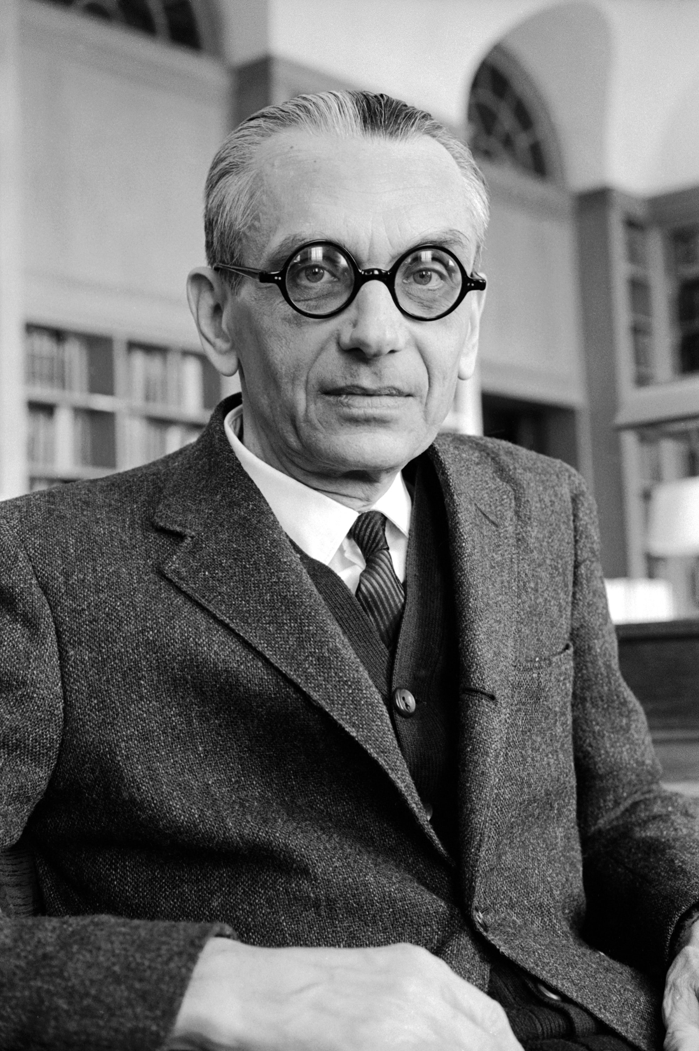
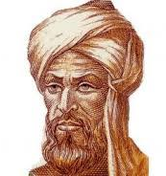
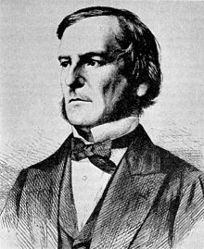
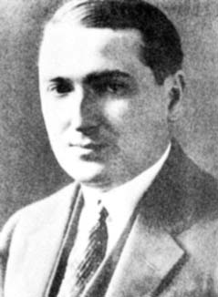
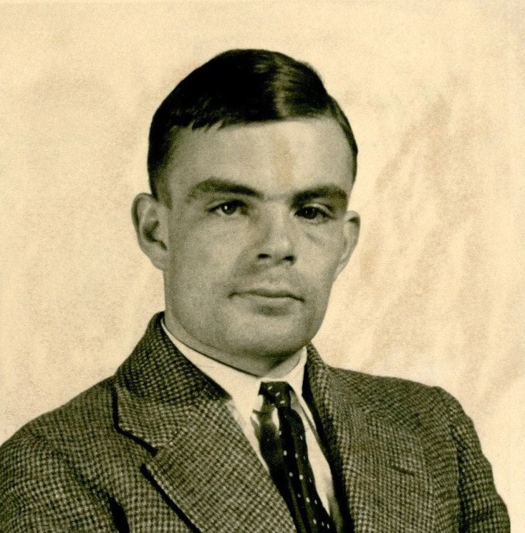
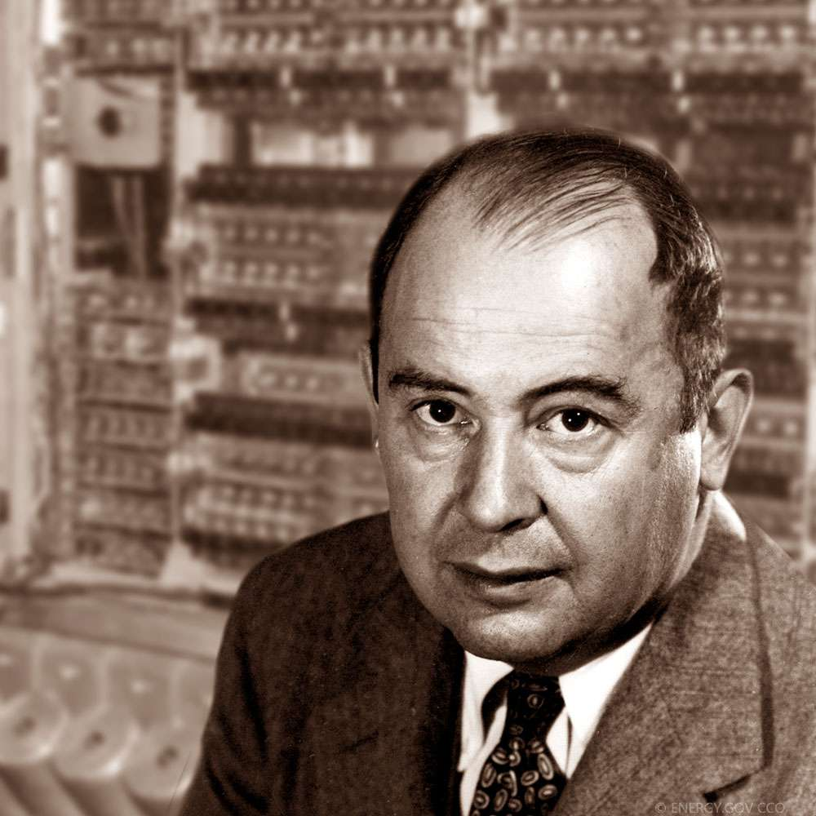
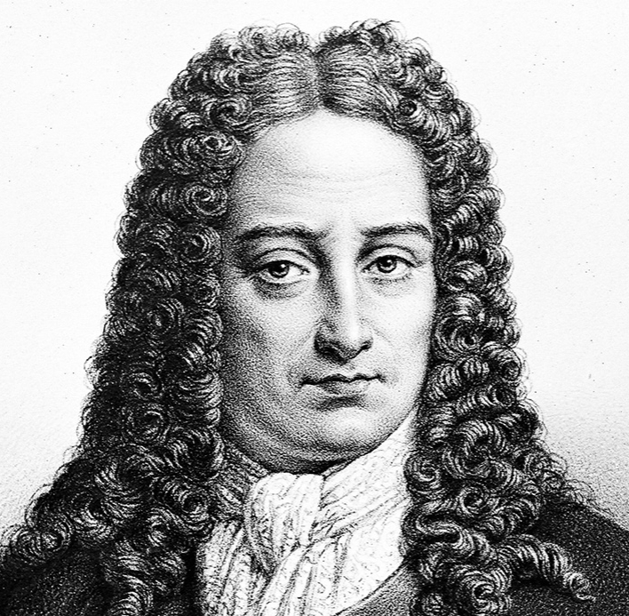

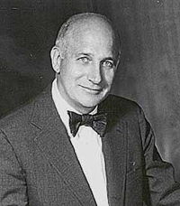
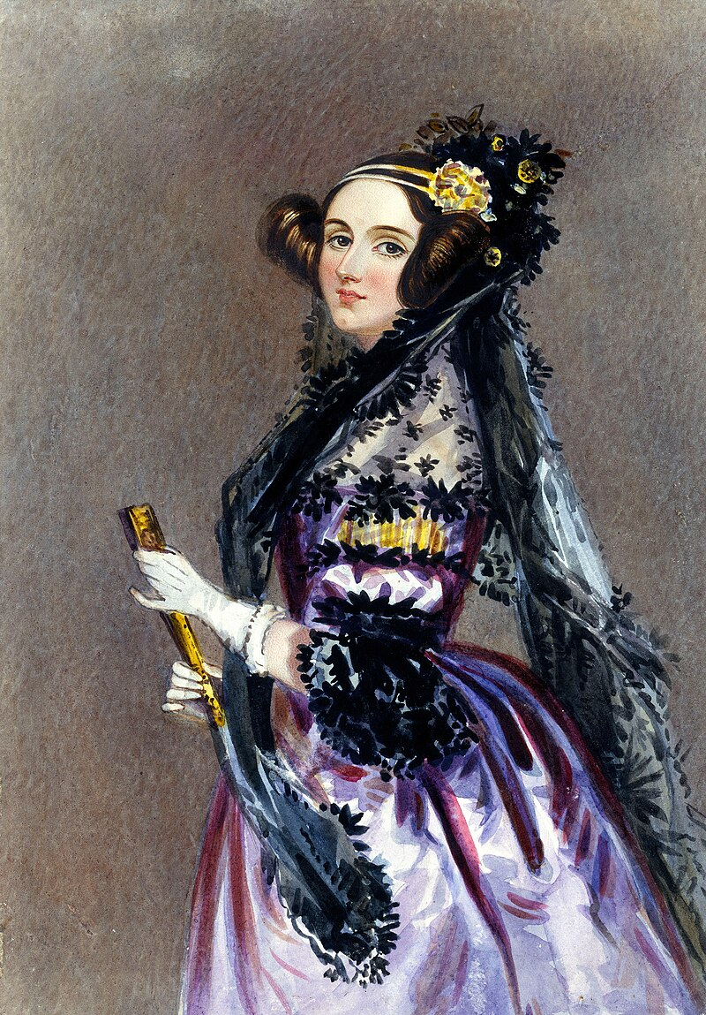
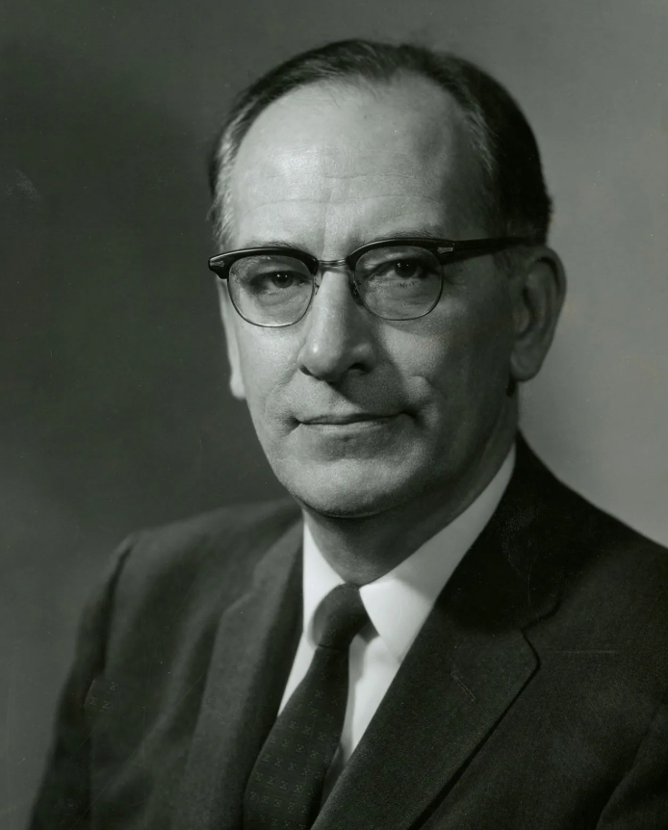
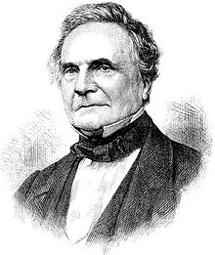
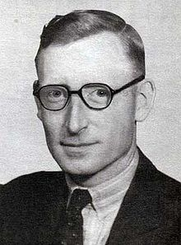

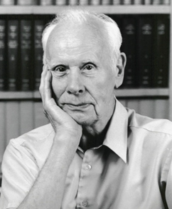
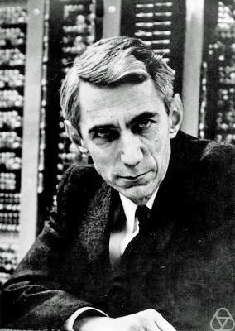
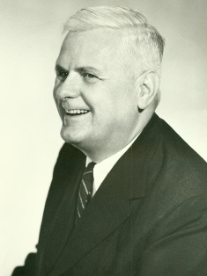

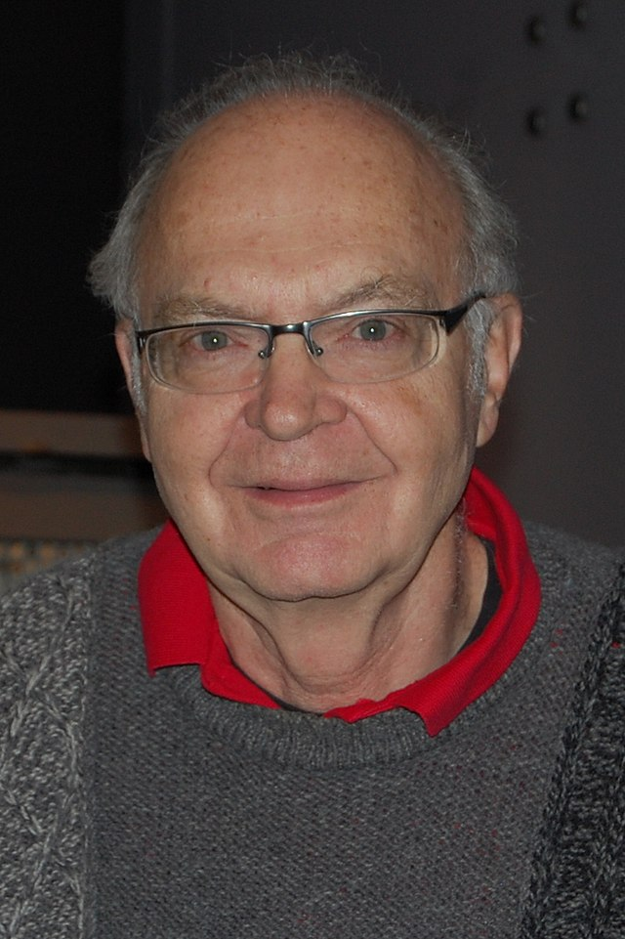
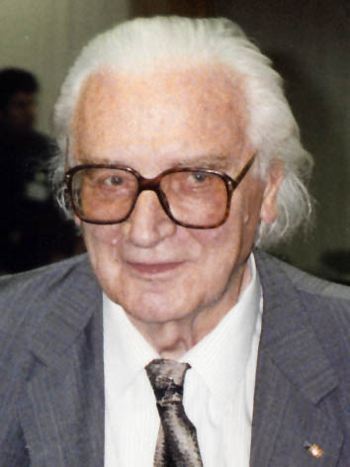
Computer science
K. F. Gödel
E. Post
M. Al-Khwarizmi
G. Boole
G. W. von Leibniz
J. P. Eckert
Alan Turing
John Von
Neumann
A. Lovelace
J. Mauchly
C. Babbage
T. Flowers
G. Stibiz
Claude Shannon
Alonzo Church
Grace Hopper
Donald Knuth
K. Zuse

Slide 5
What are the 3 fundamental parts of a computer?

Slide 6
What are the 3 fundamental parts of a computer?
Disk storage (hard drive)
Computation (Central Processing Unit, CPU)
Temporary memory (Random Access Memory, RAM)
When programs are executed
Loaded from hard drive to RAM
CPU reads and writes information from/to RAM*
Eventually, results might be written back to hard drive
*There are also intermediate memories, like cache, but that’s not too important

Slide 7
Why should we care?
RAM data is volatile, hard drive data stays
Why does RAM exist, then?

Slide 8

Why should we care?
RAM data is volatile, hard drive data stays
Why does RAM exist, then?
Access to RAM is F A S T E R (by orders of magnitude!)
Reading and writing to hard drive is slow

Slide 9
Practical advice
Avoid reading and writing to/from disk more than necessary
Ideally, load everything at the beginning, write at the end
However, we might want to save intermediate results
You can improve speed by using more RAM
For example, store results of computations (no recomputing)
However, your amount of RAM is limited (out of memory errors)
OOM errors are the most common errors I got
Memory/CPU trade-off

Slide 10
Memory management
Everything in a computer is stored as…?

Slide 11
Memory management
Everything in a computer is stored as bits! 0/1
One single element is a bit, 8 bits make a Byte (octet)
If you RAM memory is 16 GB (GigaBytes), it means it can store up to 16 * 10^9 Bytes (and even more, using tricks)
Memory is now so large that minimal amounts are kB (10^3 Bytes)
Estimate or measure how much memory your program takes
E.g. in Python a float takes 8 Bytes (8*8=64 bits)
So you could store ~2 * 10^9 Python floats in RAM memory
But your operative system is also using memory; and so are all the other running programs, so in practice much less

Slide 12
Memory management
Memory management
Get rid of the stuff in memory you no longer use
Load new stuff in memory, properly
How do you do that in Python?

Slide 13
Memory management
Memory management
Get rid of the stuff in memory you no longer use
Load new stuff in memory, properly
How do you do that in Python?
YOU DON’T*
Python does that for you (garbage collector)
*however, the GC is not perfect, and you can invoke it manually
See the documentation of the gc Python package

Slide 14
Practical advice
Other languages allow for more precise control of memory
C, C++ (they are also called more low-level)
They are also much faster, but way more annoying
Screw up memory allocation -> program crashes (segmentation fault, aka “there is a problem somewhere”)

Slide 15
Why are some languages faster than others?
Fast languages
Assembly, C, C++, Fortran, …
Slow languages
Java, Python, R, …

Slide 16
Why are some languages faster than others?
Compiled vs Interpreted
Computers represent EVERYTHING as bits
Including instructions!

Slide 17
Working directory

